Slide 1
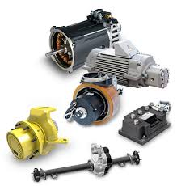
Electrical Drives

Slide 2
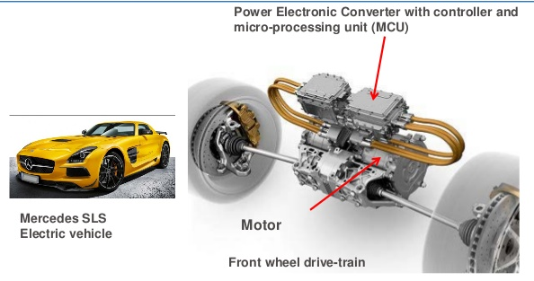
Concept of Electrical Drives
System employed for motion control-Drives
Drives employing Electrical Motor –Electrical Drives

Slide 3
Advantages of Electrical Drives
They have flexible control Characteristics
Available in wide range of Torque , speed , power
High efficiency for electric motors,
- low no load loss, short time overloading capacity, Long life , low noise , low maintenance, cleaner
4. Adaptable to any operating Conditions
- Explosive, Radio active, Liquids, Vertical Mountings
5. Do not pollute environment

Slide 4
Advantages of Electrical Drives
6.Can operate in any four Quadrant of speed torque plane
7.No need of refuel and warm up the motor
8.They are powered by electrical energy which has number of advantages over any other form of energy

Slide 5
Electric drives are environment friendly as they do not produce smoke, fumes, ash, etc. Therefore, electric drives are most suited for the underground and tube railways.
Electric drives are flexible because their performance can be controlled effectively by using electronic devices such as SCRs, IGBTs and microcontrollers.
Available in wide range of torque, speed and power.
Compact in size; electric drives occupy less space.
Do not require warm-up time; they can be started immediately.
Electric drives can be remote controlled.
A reliable source of drive.
Powered by electrical energy which has a number of advantages over other sources of energy.

Slide 6
Adaptable to different operating conditions such as submerged in liquid, explosive chemical or mining environment, radioactive environment, etc.
Electric drives have high schedule speed, high traffic handling capacity and hence require less terminal space.
Require less maintenance cost and less maintenance time. Electric drives are economical.

Slide 7
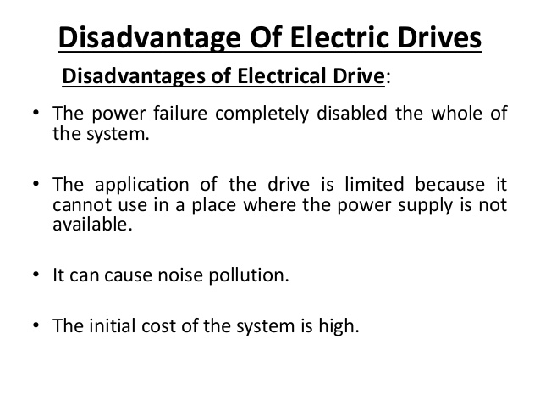

Slide 8
The capital cost of installing an electric drive is high.
Electric drives are suitable only on electrified tracks.
Electric drives require additional control circuitry.
Sometimes, electric drives can cause noise pollution.
Electric drives have poor dynamic response.
Power failure can completely disable an electric drive.
The output power obtained from an electric drive is low.

Slide 9
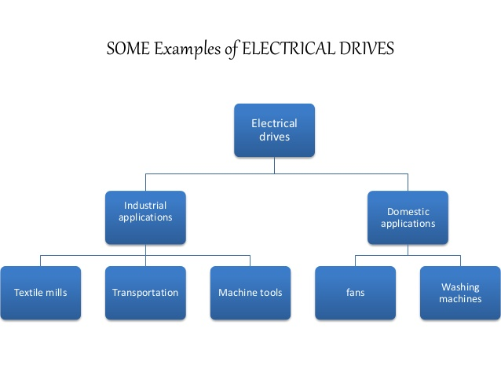

Slide 10
Applications
Paper mills
Cement Mills
Textile mills
Sugar Mills
Steel Mills
Electric Traction
Petrochemical Industries
Electrical Vehicles

Slide 11
Applications
The main application of this drive is electric traction which means transportation of materials from one location to another location. The different types of electric tractions mainly include electric trains, buses, trolleys, trams, and solar-powered vehicles inbuilt with battery.
Electrical drives are extensively used in the huge number of domestic as well as industrial applications which includes motors, transportation systems, factories, textile mills, pumps, fans, robots, etc.
These are used as main movers for petrol or diesel engines, turbines like gas otherwise steam, motors like hydraulic & electric.

Slide 12
A modern variable speed electrical drive system has the following components
Electrical machines and loads
Power Modulator
Sources
Control unit
Sensing unit
Electrical Machines
Most commonly used electrical machines for speed control applications are the following
DC Machines
Shunt, series, compound, separately excited DC motors and switched reluctance machines.
AC Machines
Induction, wound rotor, synchronous, PM synchronous and synchronous reluctance machines.
Special Machines
Brush less DC motors, stepper motors, switched reluctance motors are used.

Slide 13
Block Diagram of Electrical Drives
Source
Power Modulators
Motors
Load
Control Unit
Sensing Unit
Input Command

Slide 14
Power Modulators-functions
1. Modulates flow of power from the source to the motor in such a manner that motor is imparted speed-torque characteristics required by the load.
2. During transient Conditions, it restricts source and motor currents within permissible limits
3. Converts Electrical Energy of Source in the form suitable to motor
4. Select modes of operation of Motor-Motoring or Braking

Slide 15
Types of Power Modulators
In the electric drive system, the power modulators can be any one of the following
Controlled rectifiers (AC to DC converters)
Inverters (DC to AC converters)
AC voltage controllers (AC to AC converters)
DC choppers (DC to DC converters)
Cyclo converters (Frequency conversion)

Slide 16
Electrical Sources
Very low power drives are generally fed from single phase sources. Rest of the drives is powered from a 3 phase source. Low and medium power motors are fed from a 400v supply. For higher ratings, motors may be rated at 3.3KV, 6.6KV and 11 KV. Some drives are powered from battery.

Slide 17
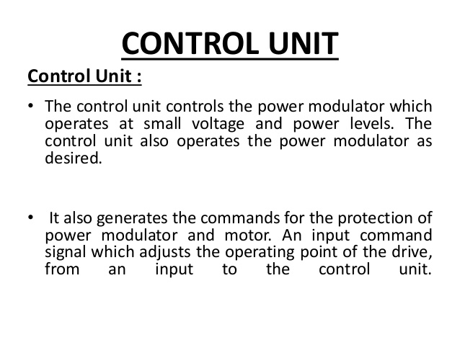

Slide 18
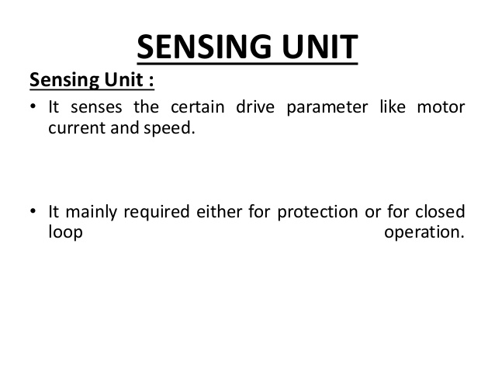

Slide 19
Sensing Unit
Speed Sensing (From Motor)
Torque Sensing
Position Sensing
Current sensing and Voltage Sensing from Lines or from motor terminals
From Load
Torque sensing
Temperature Sensing

Slide 20
Classification of Electric Drives
According to Mode of Operation
Continuous duty drives
Short time duty drives
Intermittent duty drives
According to Means of Control
Manual
Semi automatic
Automatic
According to Number of machines
Individual drive
Group drive
Multi-motor drive
According to Dynamics and Transients
Uncontrolled transient period
Controlled transient period
According to Methods of Speed Control
Reversible and non-reversible
uncontrolled constant speed.
Reversible and non-reversible step speed control.
Variable position control.
Reversible and non-reversible smooth speed cont

Slide 21
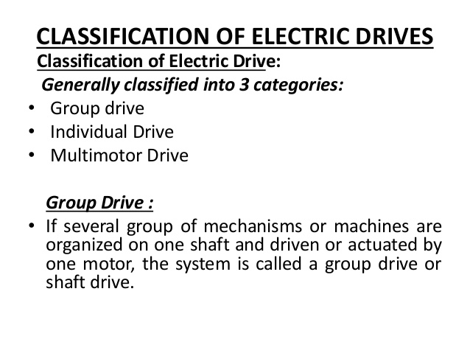

Slide 22
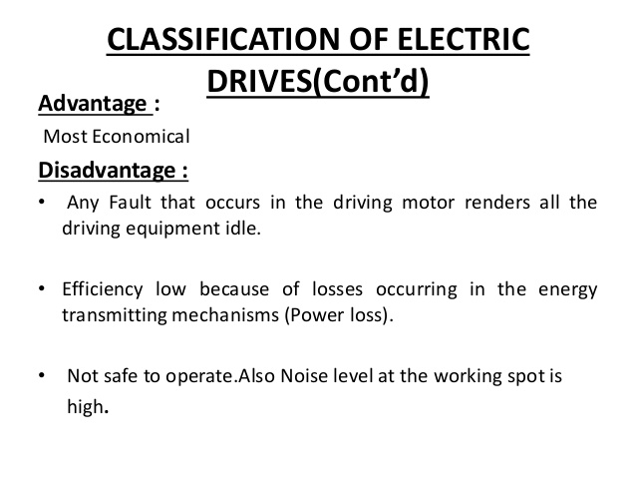

Slide 23
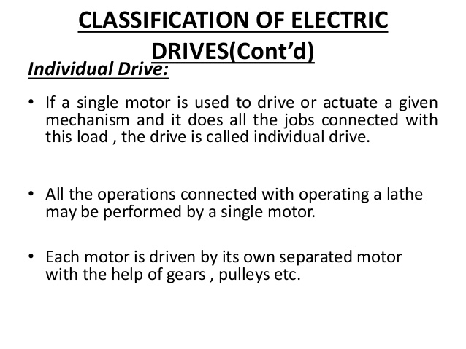

Slide 24
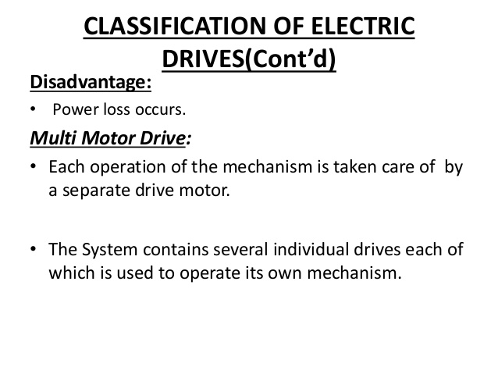

Slide 25
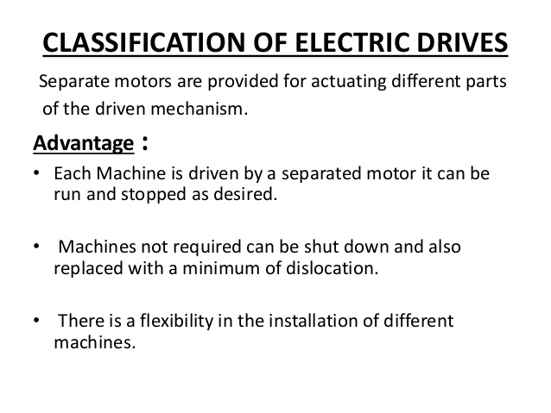

Slide 26
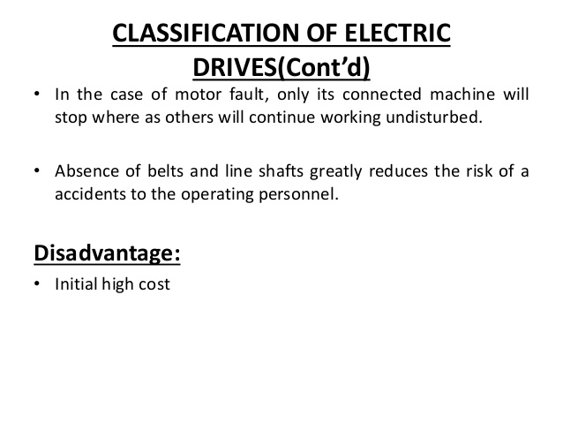

Slide 27
Comparison between DC and AC drives
DC DRIVES | AC DRIVES
The power circuit and control circuit is simple and inexpensive | The power circuit and control circuit are complex
It requires frequent maintenance | Less Maintenance
The commutator makes the motor bulky, costly and heavy | These problems are not there in these motors and are inexpensive, particularly squirrel cage induction motors
Fast response and wide speed range of control, can be achieved smoothly by conventional and solid state control | In solid state control the speed range is wide and conventional method is stepped and limited
Speed and design ratings are limited due to commutations | Speed and design ratings have upper limits

Slide 28
Choice (or) Selection of Electrical Drives
Choice of an electric drive depends on a number of factors. Some of the important factors are.
Steady State Operating conditions requirements
Nature of speed torque characteristics, speed regulation, speed range, efficiency, duty cycle, quadrants of operation, speed fluctuations if any, ratings etc
2. Transient operation requirements
Values of acceleration and deceleration, starting, braking and reversing performance.
3. Requirements related to the source
Types of source and its capacity, magnitude of voltage, voltage fluctuations, power
factor, harmonics and their effect on other loads, ability to accept regenerative power
4. Capital and running cost, maintenance needs life.
5. Space and weight restriction if any.
6. Environment and location.
7. Reliability.

Slide 29
Factors affecting selection of motors
The characteristics of motors vary widely with the nature of their application and the type of duty they are expected to perform.
For example, the applications like constant speed, constant torque, variable speed, continuous/intermittent duty, steep/sudden starts, frequent start/stops, etc. should be taken into consideration carefully when deciding for the type of a motor for that specific application.

Slide 30
Nature of electric supply
Whether supply available is A.C. (single phase or three phase) or D.C. (pure D.C. or rectified A.C.)to be utilized for motor.
Nature of the drive
Whether motor is to drive individual machine or a group of machines.
Nature of load
Whether the load requires light or heavy starting torque.
Whether load torque increases with speed or remains constant.
Whether load has heavy inertia, which may required long starting time.
Electrical characteristics of motor
Starting characteristics.
Running characteristics.
Speed control.
Braking characteristics.

Slide 31
Size and rating of the motor
whether motor is to run continuously intermittently or on load cycle.
Whether over load capacity and pull torque are sufficient.
Mechanical considerations
Type of enclosures.
Type of bearings.
Transmission of drive
Noise leve
Cost
Capital cost.
Running cost.

Slide 32
Characteristics of Different types of Loads
One of the essential requirements in the section of a particular type of motor for driving a machine is the matching of speed-torque characteristics of the given drive unit and that of the motor.
Therefore the knowledge of how the load torque varies with speed of the driven machine is necessary. Different types of loads exhibit different speed torque characteristics.
However, most of the industrial loads can be classified into the following four categories.
Constant torque type load
Torque proportional to speed (Generator Type load)
Torque proportional to square of the speed (Fan type load)
Torque inversely proportional to speed (Constant power type load)

Slide 33
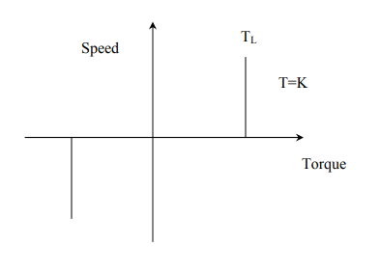
Constant Torque characteristics:
Most of the working machines that have mechanical nature of work like shaping, cutting, grinding or shearing, require constant torque irrespective of speed. Similarly cranes during the hoisting and conveyors handling constant weight of material per unit time also exhibit this type of characteristics.

Slide 34
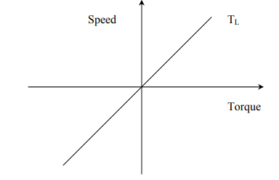
Torque Proportional to speed: Separately excited dc generators connected to a constant resistance load, eddy current brakes have speed torque characteristics given by T=kω

Slide 35
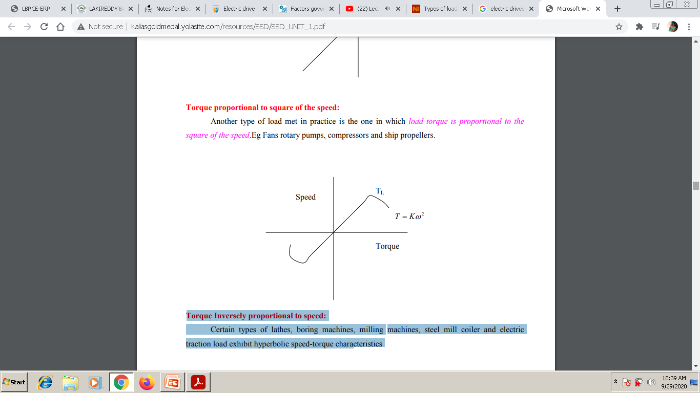

Slide 36
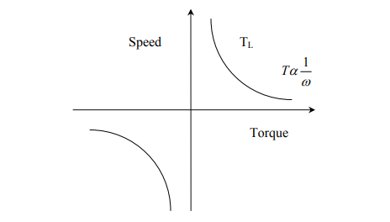
Torque Inversely proportional to speed:
Certain types of lathes, boring machines, milling machines, steel mill coiler and electric traction load exhibit hyperbolic speed-torque characteristics

Slide 37
FOUR QUADRANT OPERATION OF ELECTRIC DRIVE
For consideration of multi quadrant operation of drives, it is useful to establish suitable conventions about the signs of torque and speed.
A motor operates in two modes – Motoring and braking. In motoring, it converts electrical energy into mechanical energy, which supports its motion.
In braking it works as a generator converting mechanical energy into electrical energy and thus opposes the motion.
Motor can provide motoring and braking operations for both forward and reverse directions. Figure shows the torque and speed co-ordinates for both forward and reverse motions.
Power developed by a motor is given by the product of speed and torque. For motoring operations power developed is positive and for braking operations power developed is negative.

Slide 38
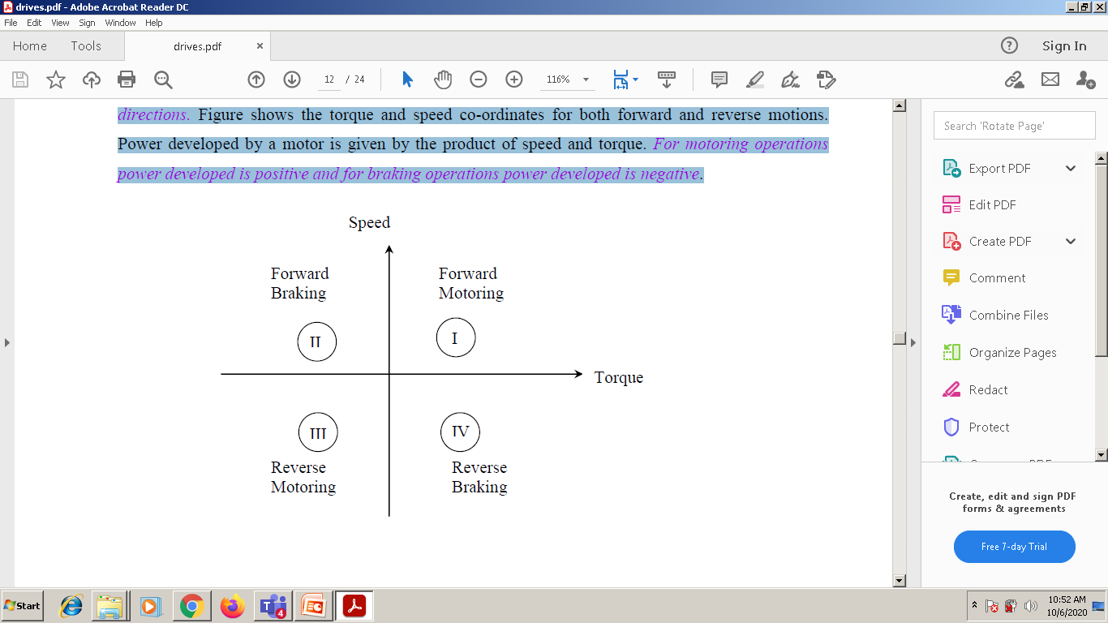

Slide 39
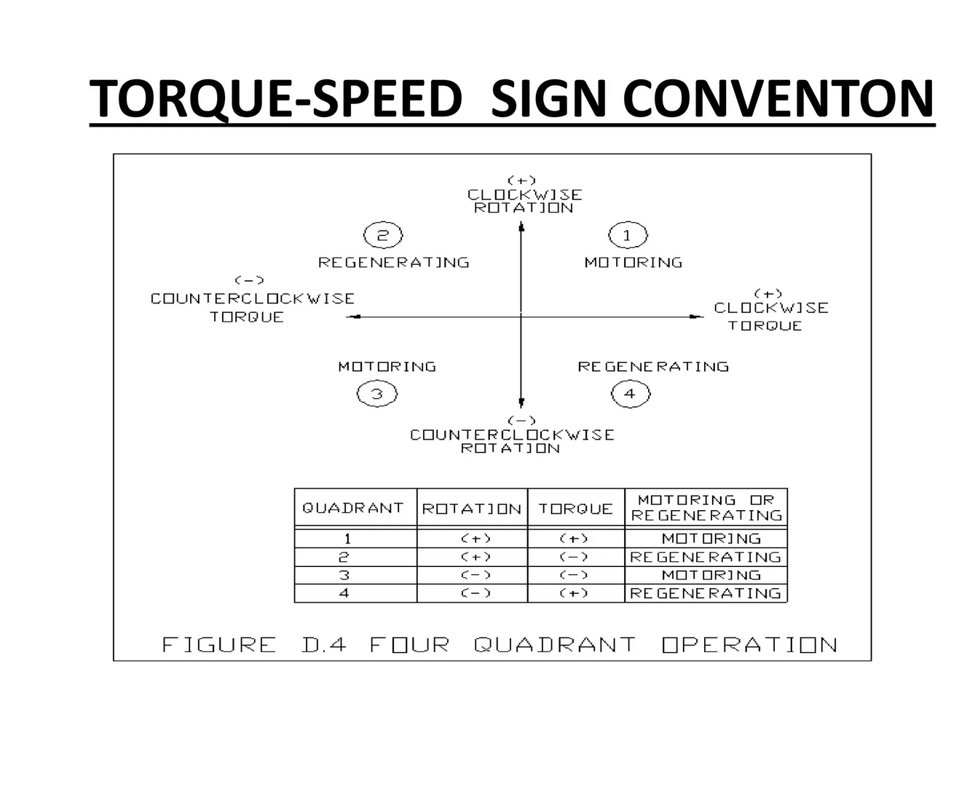

Slide 40
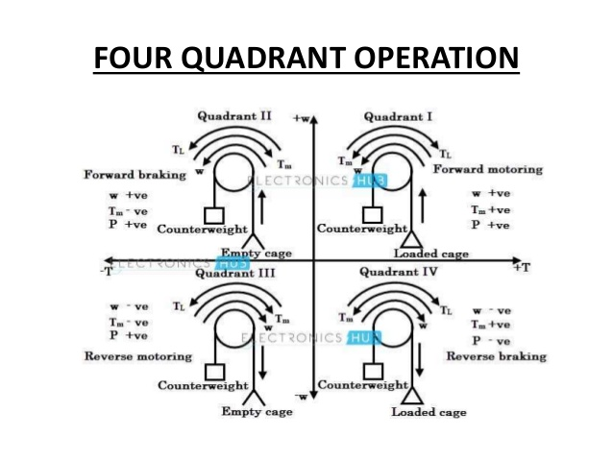

Slide 41
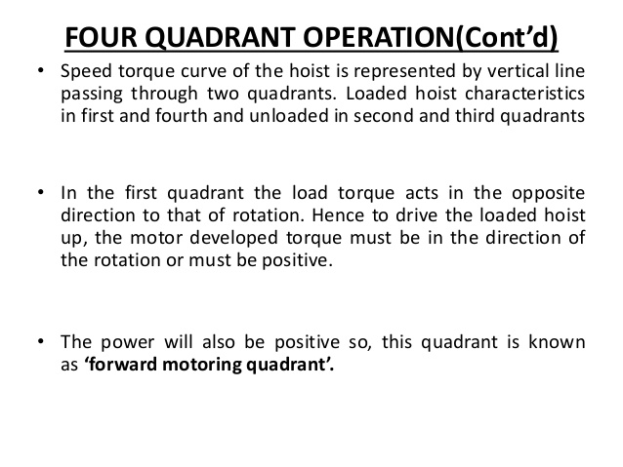

Slide 42
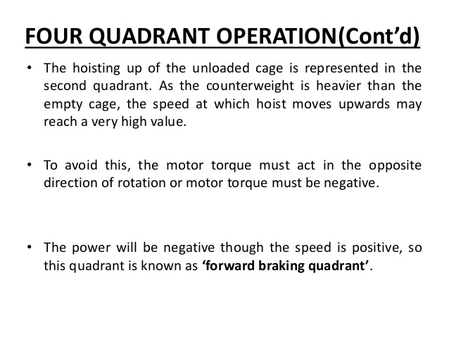

Slide 43
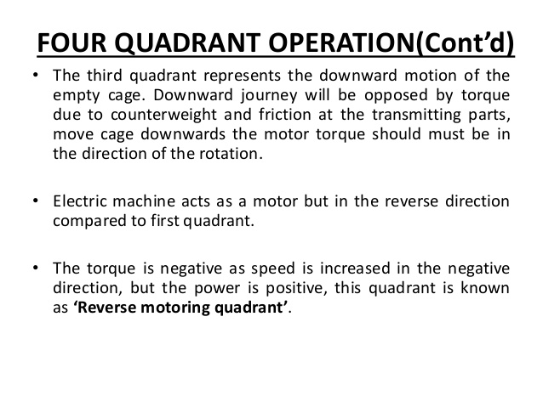

Slide 44
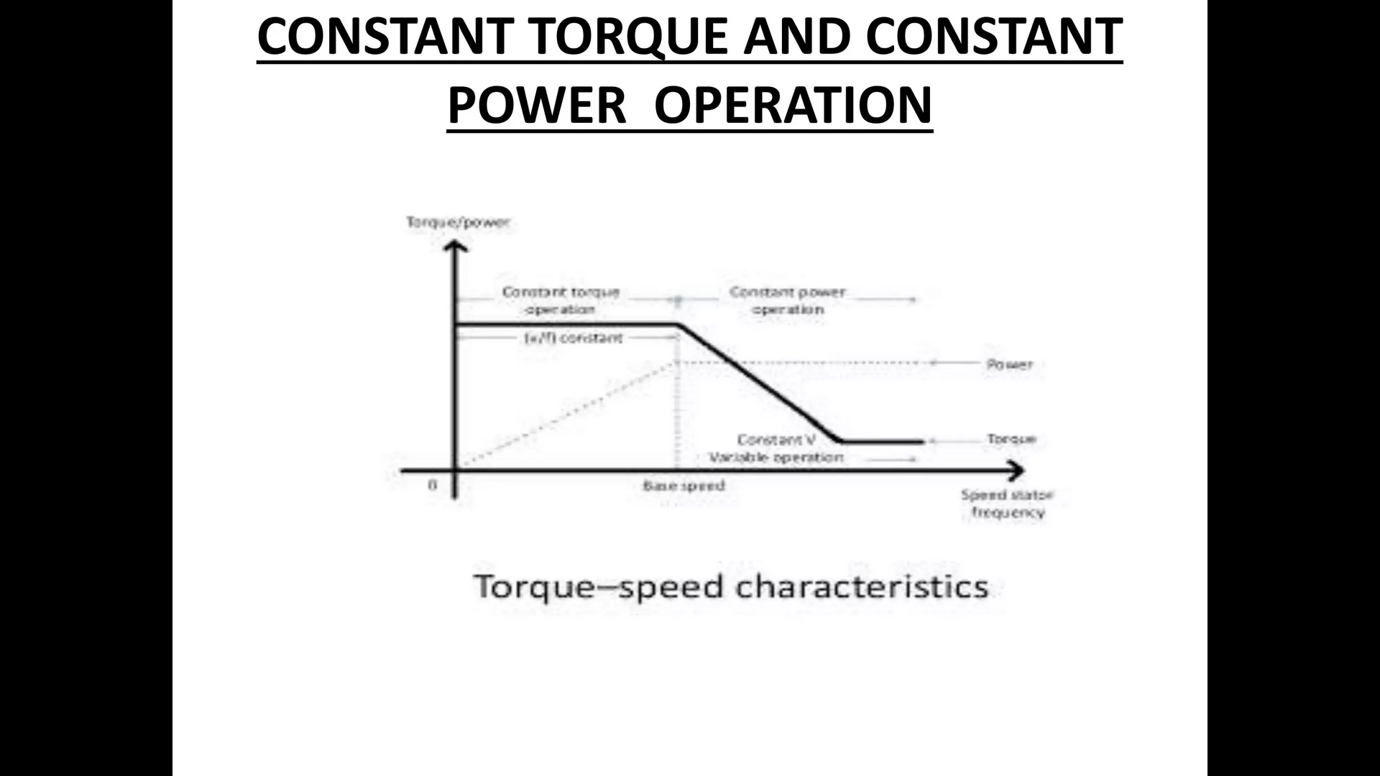

Slide 45
Steady state characteristics of Electric drives
Equilibrium speed of motor-load system can be obtained when motor torque equals the load torque. Electric drive system will operate in steady state at this speed, provided it is the speed of stable state equilibrium. Concept of steady state stability has been developed to readily evaluate the stability of an equilibrium point from the steady state speed torque curves of the motor and load system.

Slide 46
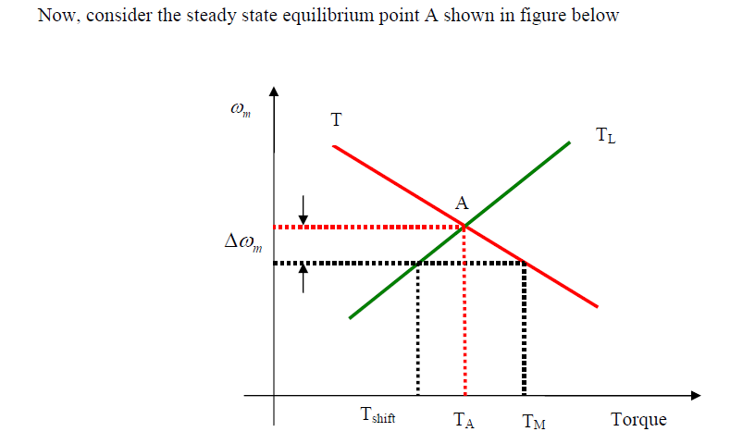

Slide 47
The equilibrium point will be termed as stable state when the operation will be restored to it after a small departure from it due to disturbance in the motor or load.
Due to disturbance a reduction of speed at new speed, electrical motor torque is greater than the load torque, consequently motor will accelerate and operation will be restores to point A.
similarly an increase in speed caused by a disturbance will make load torque greater than the motor torque, resulting into deceleration and restoring of operation to point A.

Slide 48
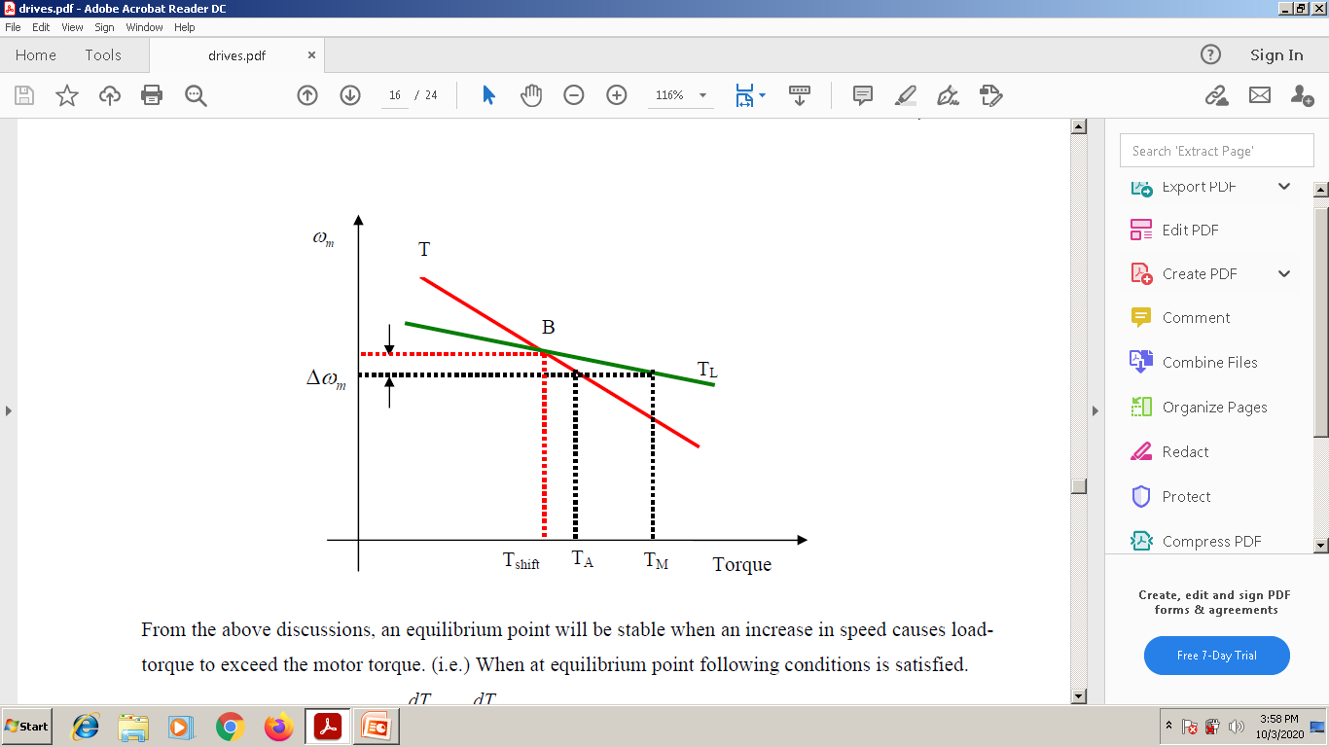
Now consider equilibrium point B which is obtained when the same motor drives another load as shown in the figure.
A decrease in speed causes the load torque to become greater than the motor torque, electric drive decelerates and operating point moves away from point B.
Similarly when working at point B and increase in speed will make motor torque greater than the load torque, which will move the operating point away from point B

Slide 49
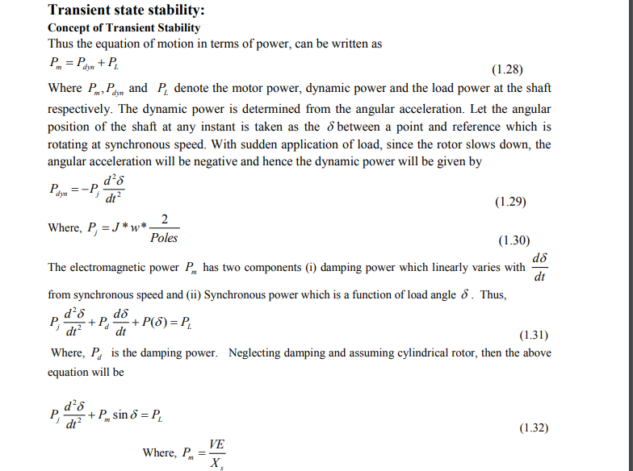

Slide 50
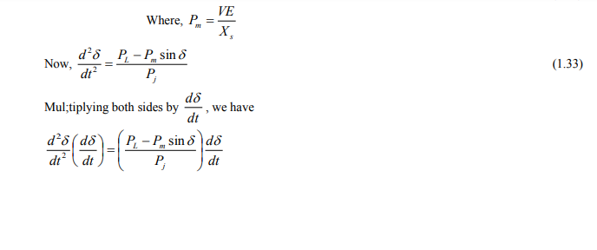
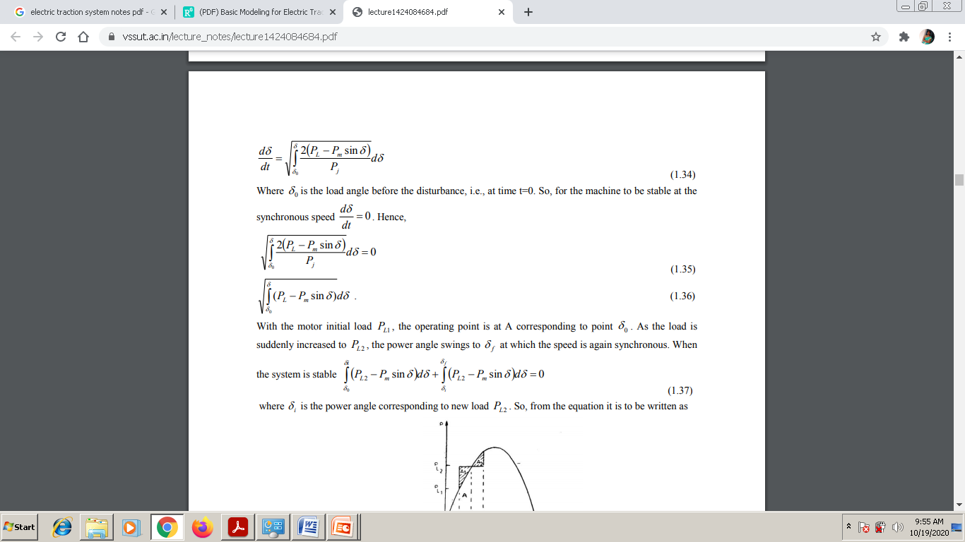

Slide 51
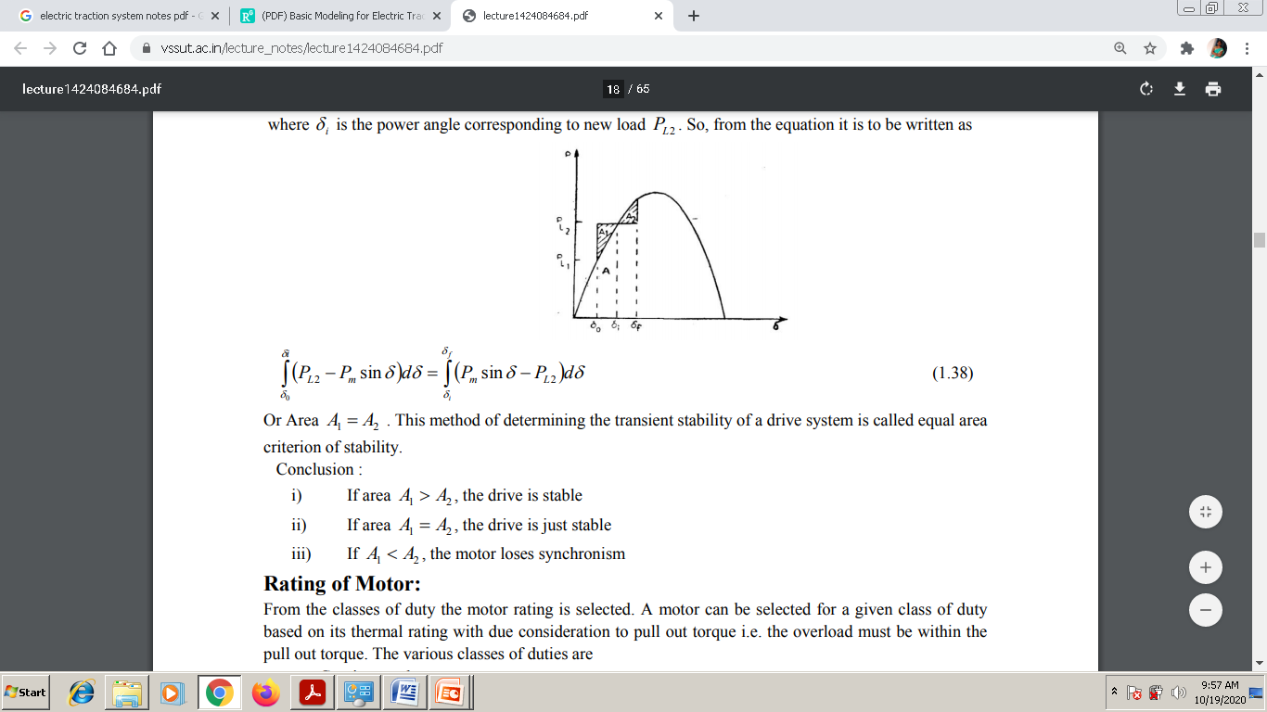

Slide 52
Size of Motor
From the classes of duty the motor rating is selected. A motor can be selected for a given class of duty based on its thermal rating with due consideration to pull out torque i.e. the overload must be within the pull out torque. The various classes of duties are
1.Continuous duty
2 . Intermittent duty
3.Short time duty

Slide 53
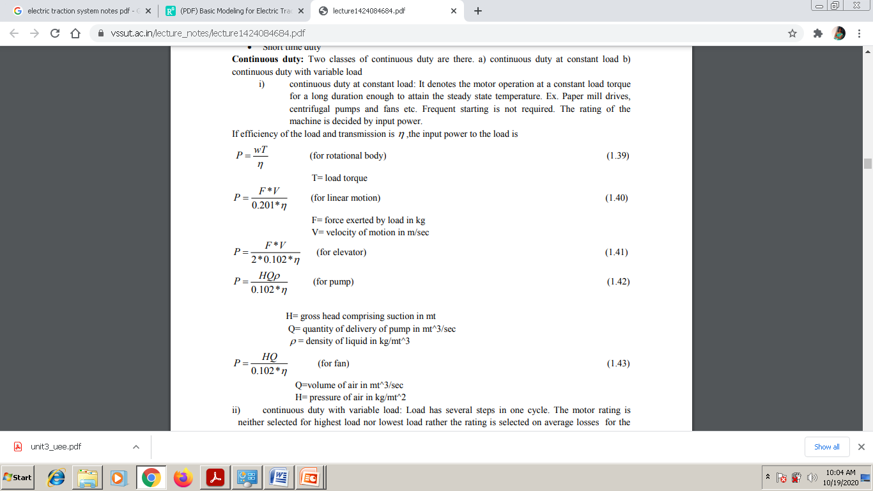

Slide 54
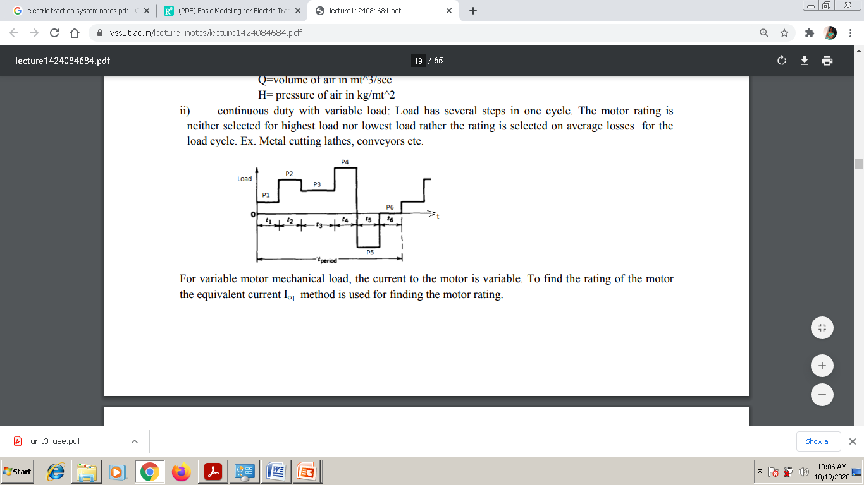

Slide 55
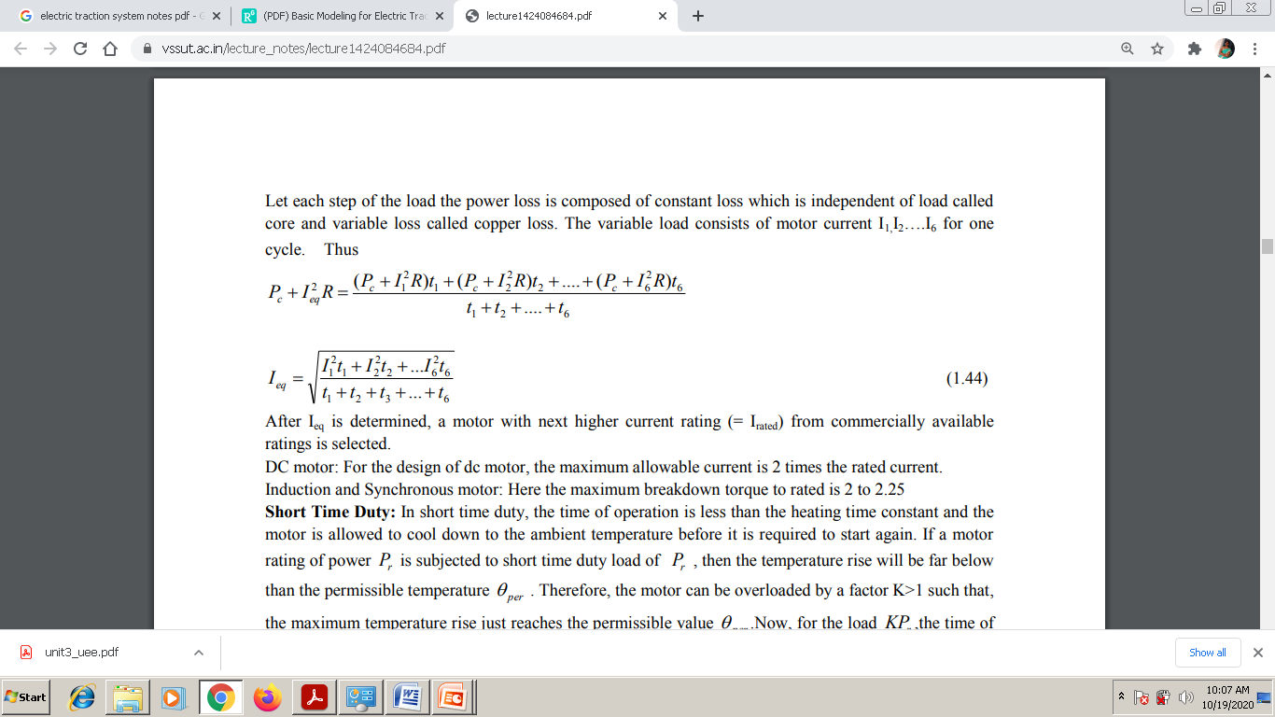

Slide 56
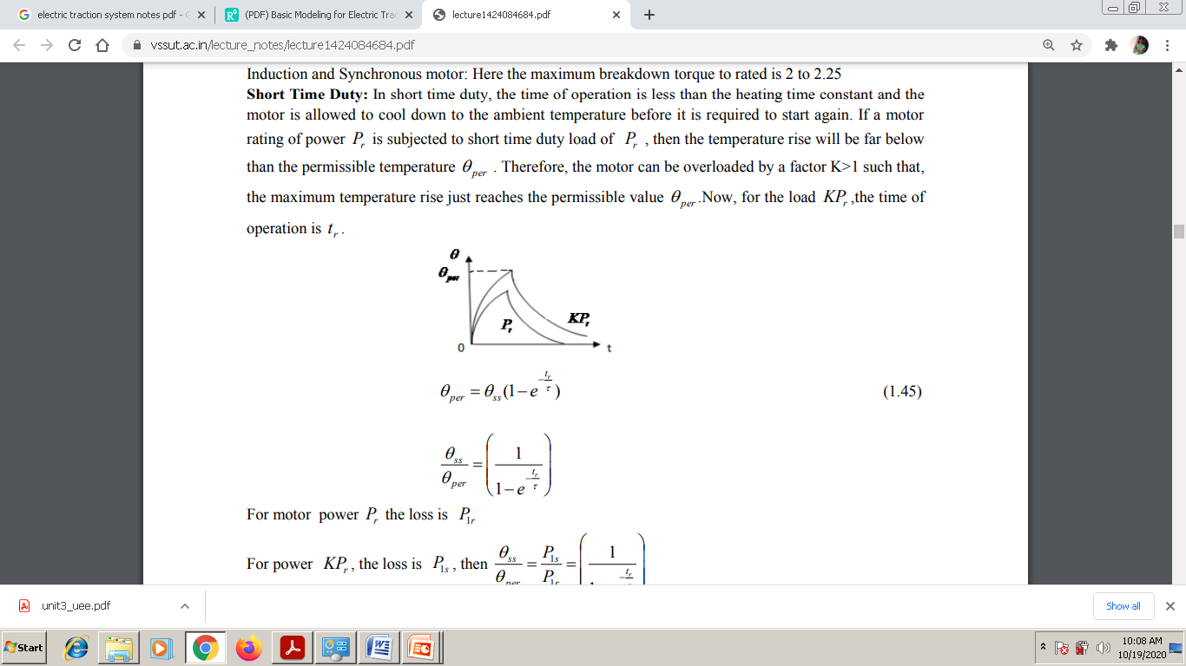

Slide 57
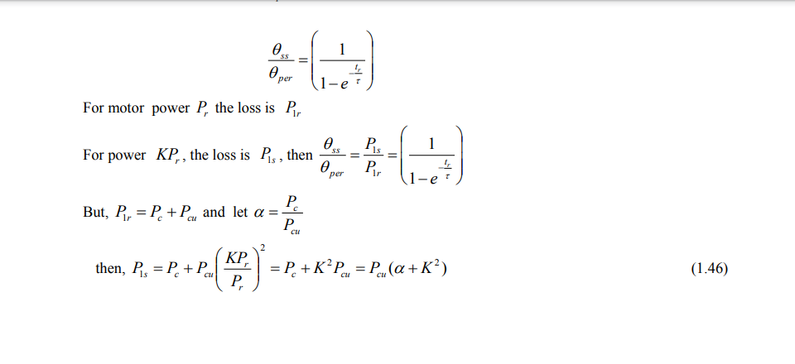
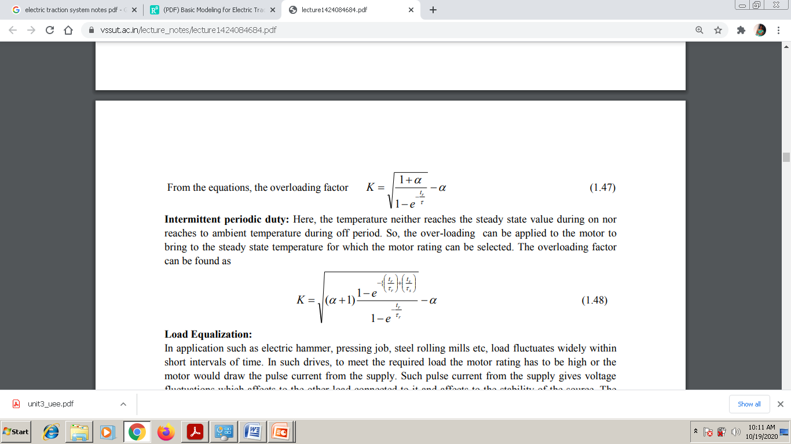

Slide 58
Load Equalisation in Electrical Drives
In some drive applications, load torque fluctuates widely within short intervals of time.
For example, in pressing machines a large torque of short duration is required during pressing operation, otherwise the torque is nearly zero.
Other examples are electric hammer, steel rolling mills and reciprocating pumps. In such drives, if motor is required to supply peak torque demanded by load, first motor rating has to be high. Secondly, motor will draw a pulsed current from the supply.
When amplitude of pulsed current forms an appreciable proportion of supply line capacity, it gives rise to line voltage fluctuations, which adversely affect other loads connected to the line.
In some applications, peak load demanded may form major proportion of the source capacity itself, as in blooming mills, then load fluctuations may also adversely affect the stability of source.

Slide 59
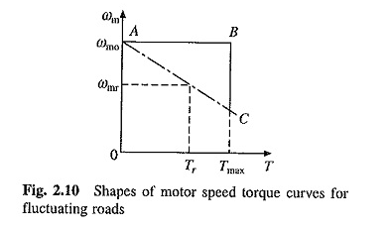

Slide 60
Above mentioned problems of fluctuating loads are overcome by mounting a flywheel on the motor shaft in non-reversible drives. Motor speed-torque characteristic is made drooping. Alternatively, by closed loop current control torque is prevented from exceeding a permissible value.
During high load period, load torque will be much larger compared to the motor torque. Deceleration occurs producing a large dynamic torque component (J dω_{m}/dt).
Dynamic torque and motor torque together are able to produce torque required by the load Because of Fig. Shapes of motor speed torque curves for deceleration, the motor speed falls.
During light load period, the motor torque exceeds the load torque causing acceleration Speed is brought back to original value before the next high load period.

Slide 61
Variation of motor and load torques, and speed for a periodic load and for a drooping motor speed-torque curve are shown in Fig.
It shows that peak torque required from the motor has much smaller value than the peak load torque. Hence, a motor with much smaller rating than peak load can be used and peak current drawn by motor from the source is reduced by a large amount.
Fluctuations in motor torque and speed are also reduced. Since power drawn from the source fluctuates very little, this is called load equalisation.

Slide 62
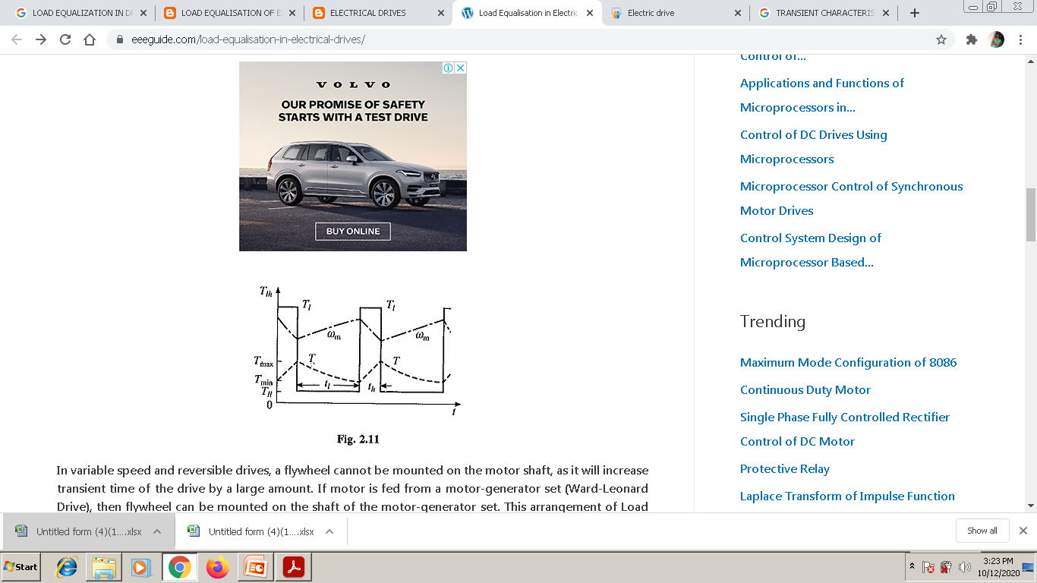

Slide 63
In variable speed and reversible drives, a flywheel cannot be mounted on the motor shaft, as it will increase transient time of the drive by a large amount.
If motor is fed from a motor-generator set (Ward-Leonard Drive), then flywheel can be mounted on the shaft of the motor-generator set.
This arrangement of Load Equalisation in Electrical Drives on the source, but not the load on motor. Consequently, a motor capable of supplying peak-load-torque is required.
Moment of inertia of the flywheel required for Load Equalisation in Electrical Drives is calculated as follows: Assuming a linear motor-speed-torque curve in the region of interest

Slide 64
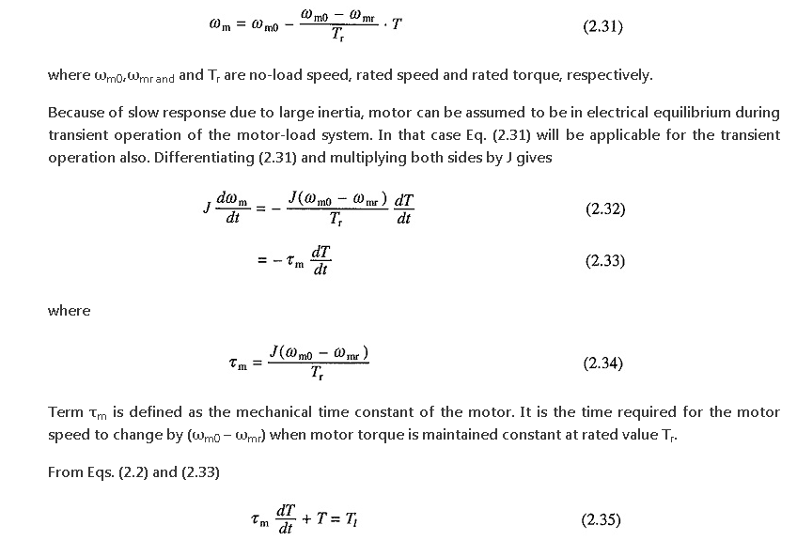

Slide 65
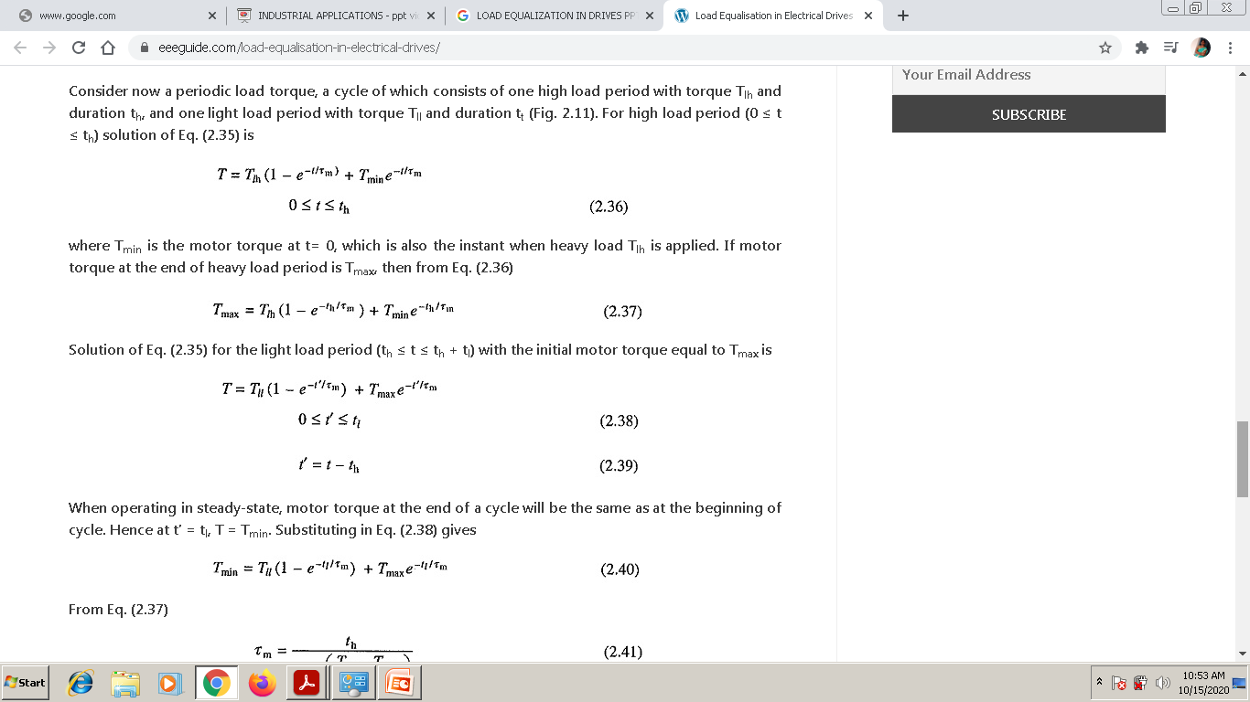

Slide 66
